Slide 1
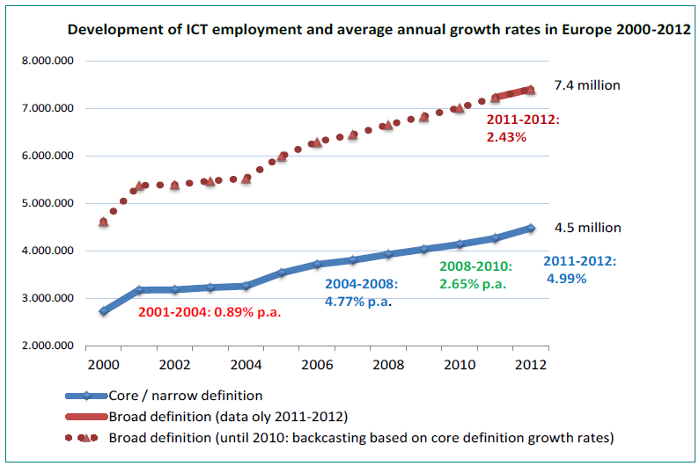
Razvoj digitalnih radnih mjesta

Slide 2
Informacijske tehnologije (IT)
U 2012. je objavljeno 1.040* oglasa.
-12% u odnosu na 2011.
U prva tri kvartala 2013. objavljeno je 1.210 oglasa
+45% u odnosu na isto razdoblje 2012.
Najtraženija zanimanja:
Programer
Web dizajner
PHP Programer
* U dijelu oglasa tražio se jedan izvršitelj za više različitih poslova.

Slide 3
Objavljeni oglasi u IT-u od 2007.

Slide 4
Prosječne plaće IT u Hrvatskoj
6.794 kn prosječna neto plaća u kategoriji IT u prva tri kvartala 2013. g.
+20% u odnosu na prosjek
Prosječne plaće za najtraženija zanimanja
Programer – 6.786 kuna
Web dizajner – 4.918 kuna
PHP Programer – 6.188 kuna

Slide 5
Prosječne plaće IT u regiji
Obrazovanje | Hrvatska | Bosna i Hercegovina | Srbija | Slovačka | Češka | Mađarska
SSS | 778 | 496 | 515 | 846 | 874 | 727
VŠS | 903 | 962 | 661 | 902 | 913 | 898
VSS (Magistar struke) | 1.015 | 694 | 706 | 1.031 | 1.042 | 1.053
Magisterij ili doktorat/MBA ili slična poslovna škola | 1.377 | - | - | 1.091 | 1.222 | 1.082
* Neto plaće u eurima, prema obrazovanju.

Slide 6
Imate li potrebe zapošljavati nove IT kadrove?
Nova radna mjesta

Slide 7
Koje profile planirate zapošljavati u 2013.

Slide 8
Broj diplomiranih ICT stručnjaka godišnje
Država | 2011.
United States | 101.557
United Kingdom | 30.913
Germany | 20.475
Poland | 18.960
Turkey | 17.667
Spain | 16.459
Netherlands | 4.512
Italy | 4.291
Czech Republic | 4.183
Greece | 3.138
Austria | 2.588
Denmark | 2.379
Slovakia | 2.309
Sweden | 2.237
Hungary | 2.147
Romania | 2.001
Belgium | 1.993
Država | 2011.
Ireland | 1.847
Switzerland | 1.774
Finland | 1.661
Bulgaria | 1.543
Croatia | 1.443
Portugal | 1.205
Norway | 1.169
Lithuania | 1.043
FYR Macedonia | 887
Latvia | 838
Slovenia | 590
Estonia | 574
Cyprus | 332
Malta | 199
Luxembourg | 45
Liechtenstein | 17

Slide 9
Strategija obrazovanja
VISOKO OBRAZOVANJE
„Proširenje kapaciteta dijela visokog obrazovanja u STEM području predstavlja razvojni prioritet…”
„Potrebno je povećati atraktivnost i konkurentnost studija, posebno u područjima od važnosti za razvoj gospodarstva (STEM)”

Slide 10
Activities
„New Opportunities – entrepreneurial eSkills“
Partner:
Croatian Independent Software Exporter’s Association (CISEx)
Target:
Young people, SME, job changers, students
Successful IT entrepreneurs revealing secrets on how to:
implement IT technology to improve business processes i.e. how to prepare functional specifications for future IT platforms
use global web channels for distributing products, goods and services throughout the global networks
take part in free-lance IT projects and gain valuable experience through job networks
use on line marketing and promotion in different branches through global netowrks: Google, Facebook, Booking, TripAdvisor… (since Croatia is strongly oriented towards tourism)
recognize global opportunities to kick start own IT job / start-up

Slide 11
Activities
Conference „ICT employment needs – research and predictions for 2014”
Partners: Croatian Employers’ Association, Croatian Chamber of Economy, Croatian Independent Software Exporters,
Target: enterprises, ICT practitioners, young people, policy makers
conference will present the annual results of research on the recruitment of IT professionals
study will include more than 450 companies that employ most of the IT specialists in Croatia
starting point for the (re)development of the curriculum at educational institutions
guidance for young people seeking career in ICT industry
great feedback for establishing procedures for accepting students to internships and thus enable their faster and better integration in the real sector
focus on trends in employment, job positions, technologies, salaries, employers…

Slide 12
Activities
Career Guidance “Digital jobs of the future“
Partners:
Job Portal MojPosao.net, Croatian Employment Services
Target:
Unemployed
presentations of on-line IT job market, most wanted professionals and positions, competencies, IT professionals careers, learning paths, recognition of prior learning, technology certificates, global job opportunities at EU job market (EURES), end user eSkills needs, self-employment possibilities, job offers on project basis, self-learning through open e-learning platforms…
assistance to local CISOK centres (Centers for information about further career guidance, within Croatian Employment Services) to organise two times a year specific consultations about IT professionalism in each of seven career guidance centres in Croatia
deploying pilot e-learning platform in CISOK centres for unemployed people, with content for end user eSkills training

Slide 13
Activities
„Grab your free Microsoft certificate“
Partners:
Microsoft Croatia, Certiport, MS Student Partners
Target:
Students in secondary schools and higher education
Along with formal education IT employers are increasingly demanding professionals with industry recognized certificates
students in high school or at faculty, can obtain an internationally recognized certificate by passing one of five offered certification exams
Microsoft Technology Associate certifications are a great choice to start
The plan is to prepare through on-line webinars and certify between 500 and 1,000 students for free

Slide 14
Activities
Award ceremony „Lifelong learning and e-Skills as an enabler of permanent employability“
Partners: Ministry of labour, Croatian Employers Association
Target:
Policy makers
Lifelong learning is definitely one of the most important factors of employability
Using the series of data from Ministry of Finance and Ministry of Labour organizers will measure the investment of companies in employees training (especially SME, regionally and through sectors, through the 5-year period) and measure the impact of training on productivity, job creation and overall company results
According to the results organisers will award companies investing the most in employers education and eSkills, showing their results and thus motivating other companies to involve more in lifelong learning activities which helps raising intellectual capital of nation

Slide 15
Activities
Training: „Google Academy of AdWords”
Partner
Croatian Employment Services, Google Regional Trainers
Target
Unemployed young people
Through this activity, 400 young unemployed young people will receive certification training in:
Google AdWords Fundamentals
Google AdWords Advanced Search
Google AdWords Advanced Display
The training and certification will be completely free for selected individuals

Slide 16
Activities
Training and open game development project “Urban Jungle”
Partner
Association of talented young IT crew
Target
Young people, ICT practitioners
„Urban Jungle” is an open project of creating multi-platform, multi-city, computer game with involvement of as many volunteers wishing to learn about game development using open-source game engine Unity3D and modern multimedia technologies.
The project has three objectives:
create an advanced version of the educational traffic simulation, with a number of cities, and still free to end users
opportunity to participate in the project to all interested parties, with organized training and
form a public domain repository of multimedia simulations to make them available to all who wish to use them for it’s own projects

Slide 17
Activities
Competition: "Idea of the year 2014 – using new technologies for business success„
Partner
The most popular web portal for high school population, srednja.hr
Target
Young people
“Idea of the year – using new technologies for business success” iwill seek for the best idea from high school students, accompanied by a business plan.
The contest will be opened to all pupils, and the top 10 teams will get a chance to present their ideas in front of businesses people and partners in the project which will pick the best team.
Exclusive criteria for this competition is to conceptually use new technologies to solve business problems or hit the opportunities to start new businesses.
Winners will go to Google

Slide 18
Activities
Facebook research: „How did we choose our future careers”
Partner
The most popular web portal for high school population, srednja.hr
Target
graduates in secondary schools and freshmen in higher education, season 2013/2014
Facebook survey on 5000 graduates and freshmen revealing:
What careers are young people expecting for themselves
Who influenced them
What guided them
Are freshment satisfied with their choice
Why are that choosing that?
STEM?

Slide 19
Activities
Educations and competition: „Step into smart world”
Partners
SAP, Students’ association for applied engineering “KASPER”, University College Algebra
Target
Students, pupils, teachers in VET schools
Establishing students’ section of excellence in applied computer engineering, based on embedded and modular development systems
Acquiring 10 educational kits for Arduino electronics prototyping platform
Creating curriculums for teachers in vocational education (technical high schools), pupils and students, with assistance of partners
Providing training for teachers and students organization, who will disseminate the knowledge between their primary groups
Lending eight prototyping kits to VET schools who will be direct partners, so they can start experimenting with the assistance of teachers
Establishing the annual SAP competition for pupils in vocational schools and students in engineering field

Slide 20
Activities
Workshops “eCitizen”
Partner
The largest Croatian loyalty program – Multiplus Card, Algebra
Target
General non-eSkilled population
Through the cooperation with the largest Croatian loyalty program, Multiplus Card, Algebra will provide free training for more than 5.000 citizen on how to use e-services which make life easier: e-banking, m-banking, everyday on-line shopping and delivery, mobile internet services…

